Slide 1
Neural Networks Viewed as Directed Graphs

Slide 2
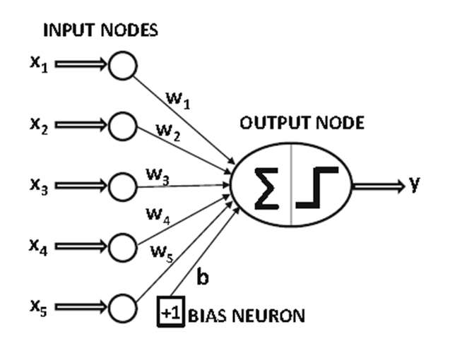
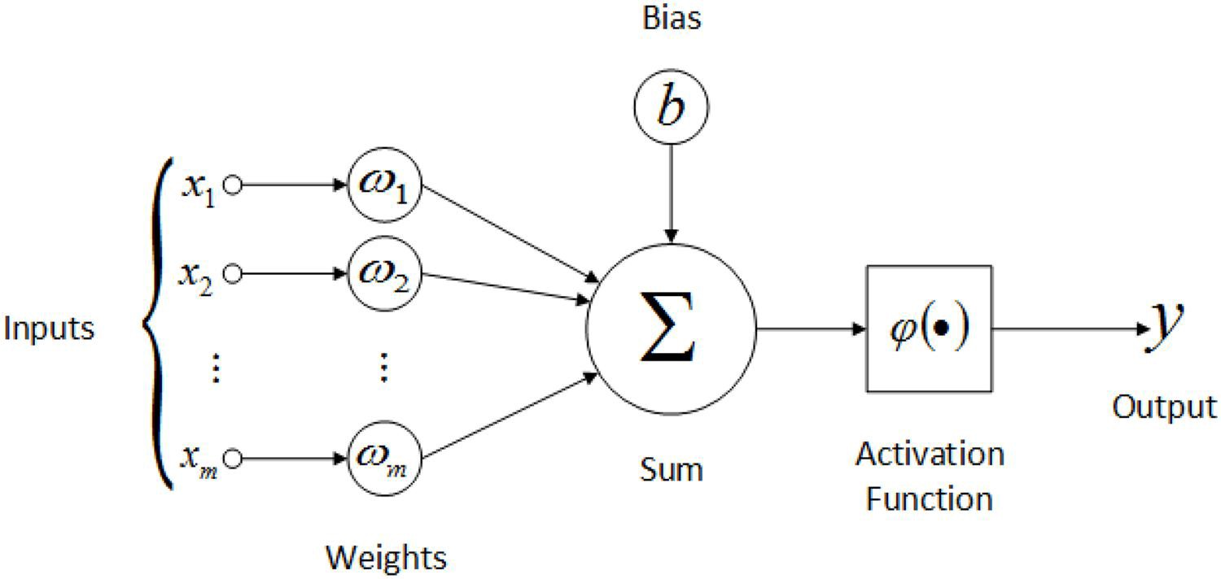
Models of a Neuron /Artificial Neuron Model/ Functional ANN
A neuron is an information-processing unit that is fundamental to the operation of a neural network.
This diagram shows the model of a neuron, which forms the basis for designing (artificial) neural networks.

Slide 3
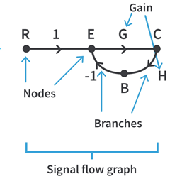
Signal Flow Graph
A signal flow graph consists of nodes and these nodes are connected by a line called branches and each branch has a small arrow which indicates the direction of the flow of signal.
A signal-flow graph is a network of directed links (branches) that are interconnected at certain points called nodes.
A node is just a point or a dot which represents a variable of the system. A branch provides a path for the flow of signal from one node to another and in the process, the signal also gets multiplied by the mentioned gain of the branch.

Slide 4
Signal Flow Graph
Input node: Node with only outgoing branches.
Output node: Node with only incoming branches. In case this condition is not met, an additional branch with unity gain can be introduced.
Path: A traversal of connected branches as per the direction indicated by the arrow on the branch such that no node is traversed more than once.
Forward Path: A path connecting the input and the output node.
Loop: A path which starts and ends at the same node.
Path gain: Product of gains associated with each branch that is encountered in traversing a path.

Slide 5
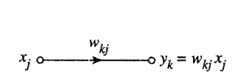

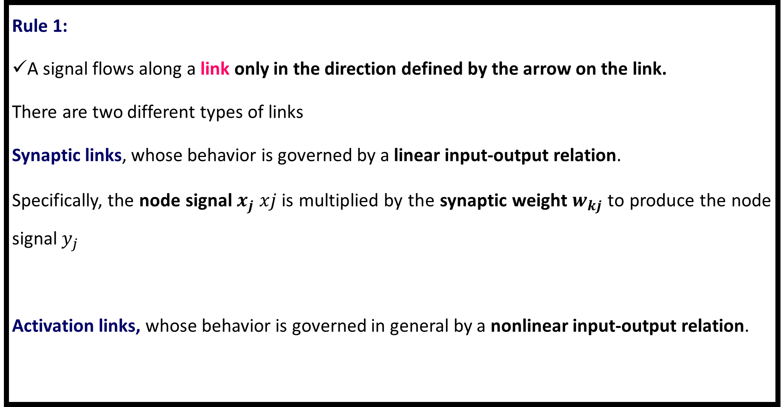
Rules for the signal flow graph
Rule 1:
A signal flows along a link only in the direction defined by the arrow on the link.
There are two different types of links
Synaptic links, whose behavior is governed by a linear input-output relation.
Specifically, the node signal${ x}_{j}$ 𝑥𝑗 is multiplied by the synaptic weight $w_{kj}$ to produce the node signal $y_{j}$
Activation links, whose behavior is governed in general by a nonlinear input-output relation.

Slide 6
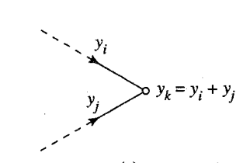
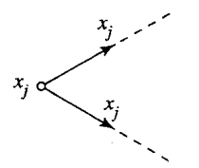
Rules for the signal flow graph
Rule 2: Input signal at a node is summation of all the signals entering at that node.
Rule 3: The output signal of the branch is the product of transmittance and input signal of that branch.
The transfer function is referred as transmittance in signal flow graph.
x is input variable node, y is output variable node and a is the transmittance of the branch connecting directly these two nodes.

Slide 7
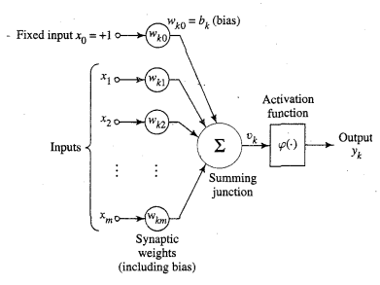
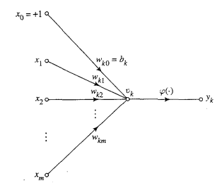
Rules for the signal flow graph
Artificial Neural Networks Signal flow graph

Slide 8
Neural Network Architectures

Slide 9
Neural Network Architectures

Slide 10
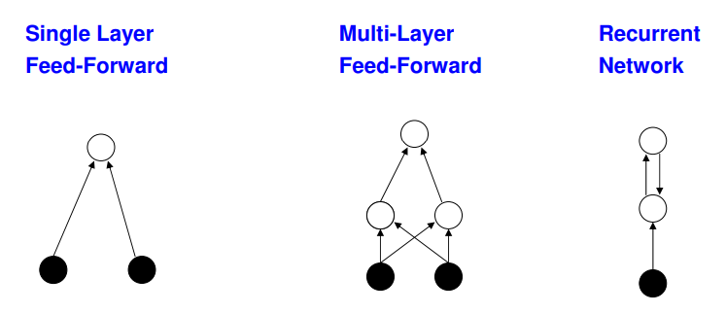
Neural Network Architectures
Single Layer Feedforward Network
Multi Layer Feedforward Network
Recurrent Networks

Slide 11
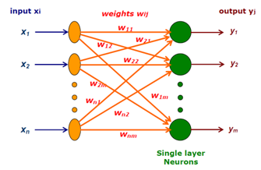
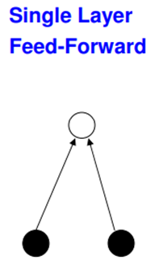
Single Layer Feedforward Network
Two Layers
Input Layer
Output Layer (Computation Nodes)
Feed forward
Input Layers neurons receive the input signals and the output Layer neurons receive the output signals
Links carrying the weights connect every input neuron to the output neuron
Information flow from input node to output node
Output layer alone perform computation

Slide 12
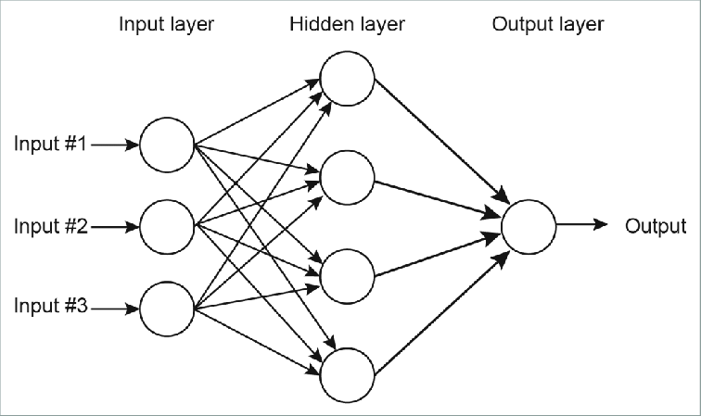
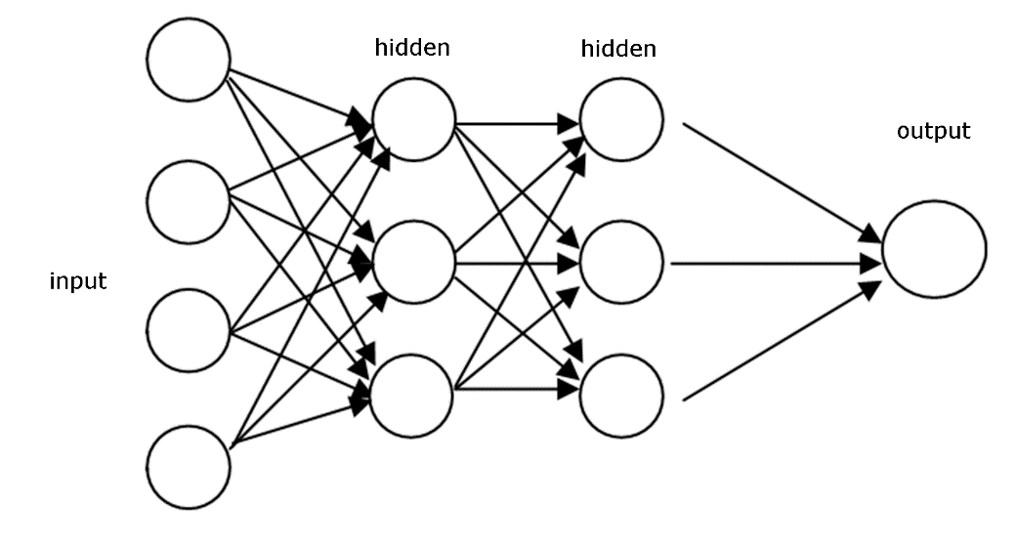
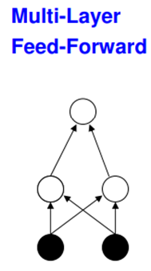
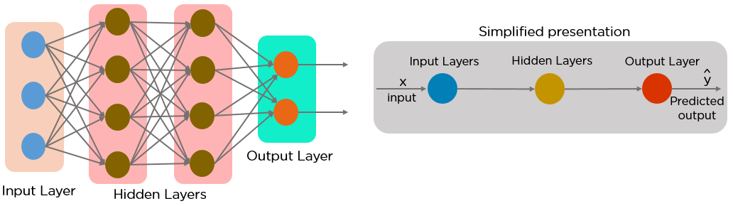
Multilayer Feedforward Network
Multilayer feedforward networks consists of Input Layer, Output Layer & one or more Hidden Layers

Slide 13
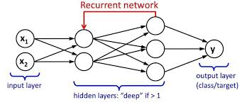

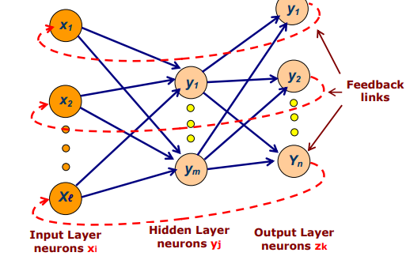
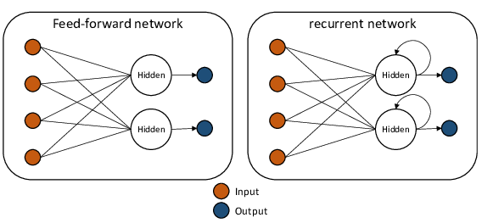
Recurrent Networks
Output from previous step are fed as input to the current step.
At least one feedback loop
With self feed-back links (output of a node is feed back into itself as input).

Slide 14
Characteristics of Neural Networks

Slide 15
Characteristics of Neural Networks
NNs display mapping capabilities:
NN can map input patterns to their associated output patterns
NNs learn by examples
NN architectures can be trained with known examples of a problem before they are tested for their inference capability on unknown instances of the problem.
Identify new objects previously untrained.
NNs possess the ability to generalize
NN can predict new outcomes from the past trends.
NNs are robust systems and are fault tolerant
Recall full patterns from incomplete, partial or noisy patterns.
NNs can process information in parallel, at high speed, and in a distributed manner.

Slide 16
ANN learning Methods

Slide 17
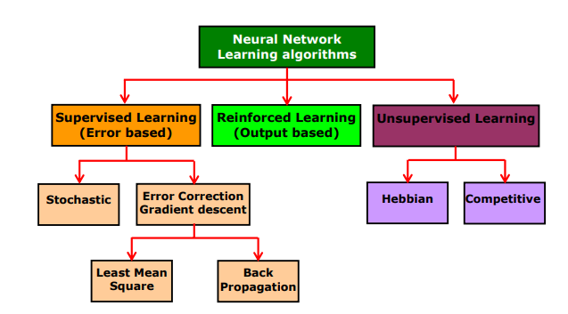
ANN learning Methods

Slide 19
Learning methods of Neural Network
Supervised Learning:
Every input pattern that is used to train the network is associated with a target or the desired output pattern
Tasks that fall under this category are Pattern Recognition and Regression.
Unsupervised Learning:
Target output is not presented to the network.
The system learns of its own by discovering and adapting to structural features in the input patterns
Tasks that fall under this category includes Clustering, Compression and Filtering.
Reinforced Learning:
In this method, the teacher though available, does not present the expected answer but only indicates if the computed output is correct or incorrect.
The information provided helps the network in its learning process.

Slide 20
Unsupervised Learning Methods of Neural Network
Competitive:
Those neurons which respond strongly to the input stimuli have their weights updated
When an input pattern is presented all neurons in the layer compete, and the winning neuron undergoes weight adjustment
Called winner-takes -all
Hebbian Learning:
The neuropsychologist Donald Hebb postulated in 1949 how biological neurons learn:
“When an axon of cell A is near enough to excite a cell B and repeatedly or persistently takes part in firing it, some growth process or metabolic change takes place on one or both cells such that A’s efficiency as one of the cells firing B, is increased.”
If two neurons are active at the same time then the strength between them should be increased

Slide 21
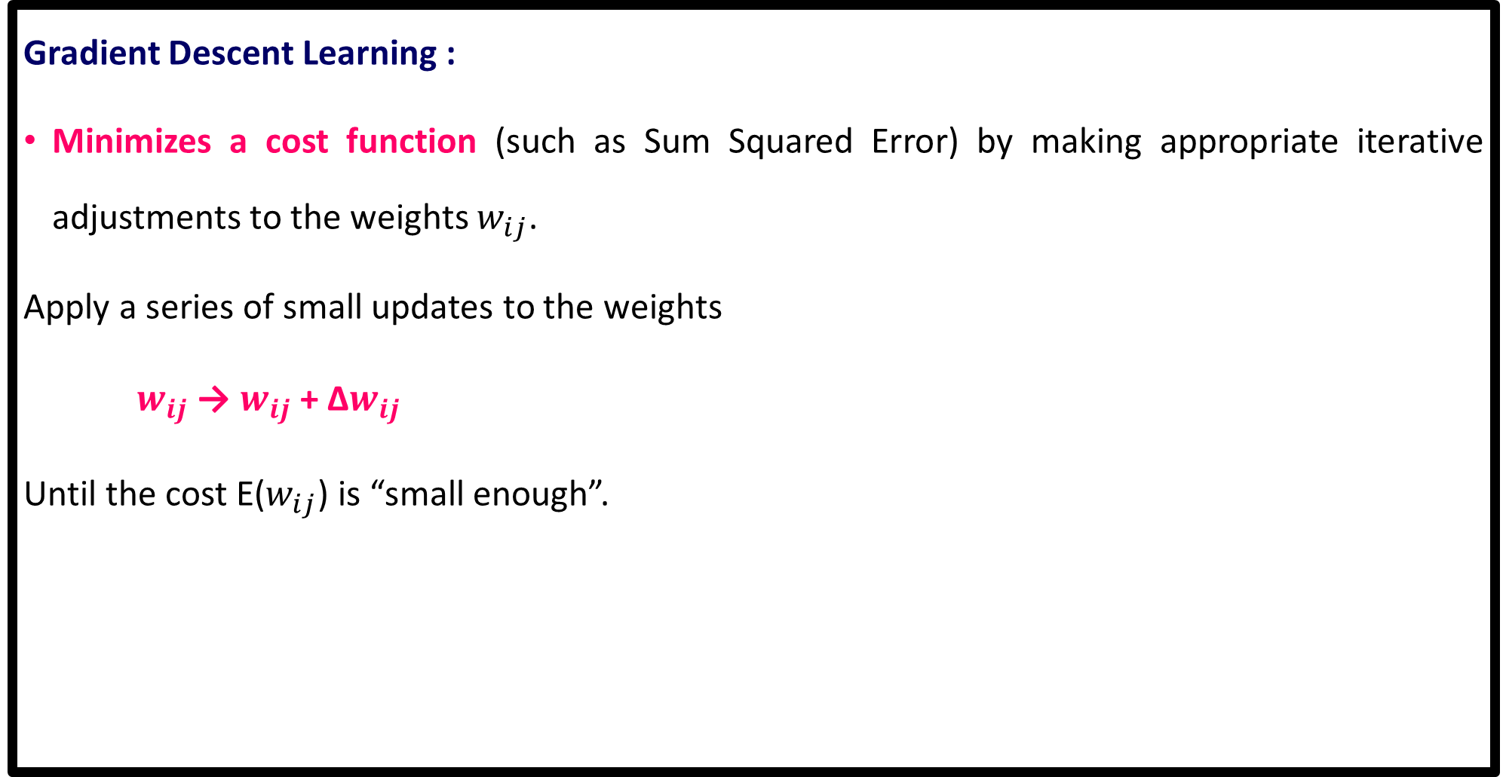
Supervised Learning Methods of Neural Network
Gradient Descent Learning :
Minimizes a cost function (such as Sum Squared Error) by making appropriate iterative adjustments to the weights $w_{ij}$.
Apply a series of small updates to the weights
$w_{ij}$ → $w_{ij}$ + Δ$w_{ij}$
Until the cost E($w_{ij}$) is “small enough”.

Slide 22
Applications of Neural Networks
Social Media
Artificial Neural Networks are used heavily in Social Media.
For example, let’s take the ‘People you may know’ feature on Facebook that suggests you people that you might know in real life so that you can send them friend requests.
Well, this magical effect is achieved by using Artificial Neural Networks that analyze your profile, your interests, your current friends, and also their friends and various other factors to calculate the people you might potentially know.

Slide 23
Applications of Neural Networks
Marketing and Sales
When you log onto E-commerce sites like Amazon and Flipkart, they will recommend your products to buy based on your previous browsing history.
This is true across all new-age marketing segments like Book sites, Movie services, Hospitality sites, etc. and it is done by implementing personalized marketing.
This uses Artificial Neural Networks to identify the customer likes, dislikes, previous shopping history, etc. and then tailor the marketing campaigns accordingly.

Slide 24
Applications of Neural Networks
Healthcare
Artificial Neural Networks are used in Oncology to train algorithms that can identify cancerous tissue at the microscopic level at the same accuracy as trained physicians.
Various rare diseases may manifest in physical characteristics and can be identified in their premature stages by using Facial Analysis on the patient photos.
So the full-scale implementation of Artificial Neural Networks in the healthcare environment can only enhance the diagnostic abilities of medical experts and ultimately lead to the overall improvement in the quality of medical care all over the world.

Slide 25
Applications of Neural Networks
Healthcare
Convolutional Neural Networks are actively employed in the healthcare industry for X ray detection, CT Scan and ultrasound

